Slide 1
Asset Pricing Subteam Research Results
Andrew Kaminer, Sid Vijay, and Tia Kungwani

Slide 2
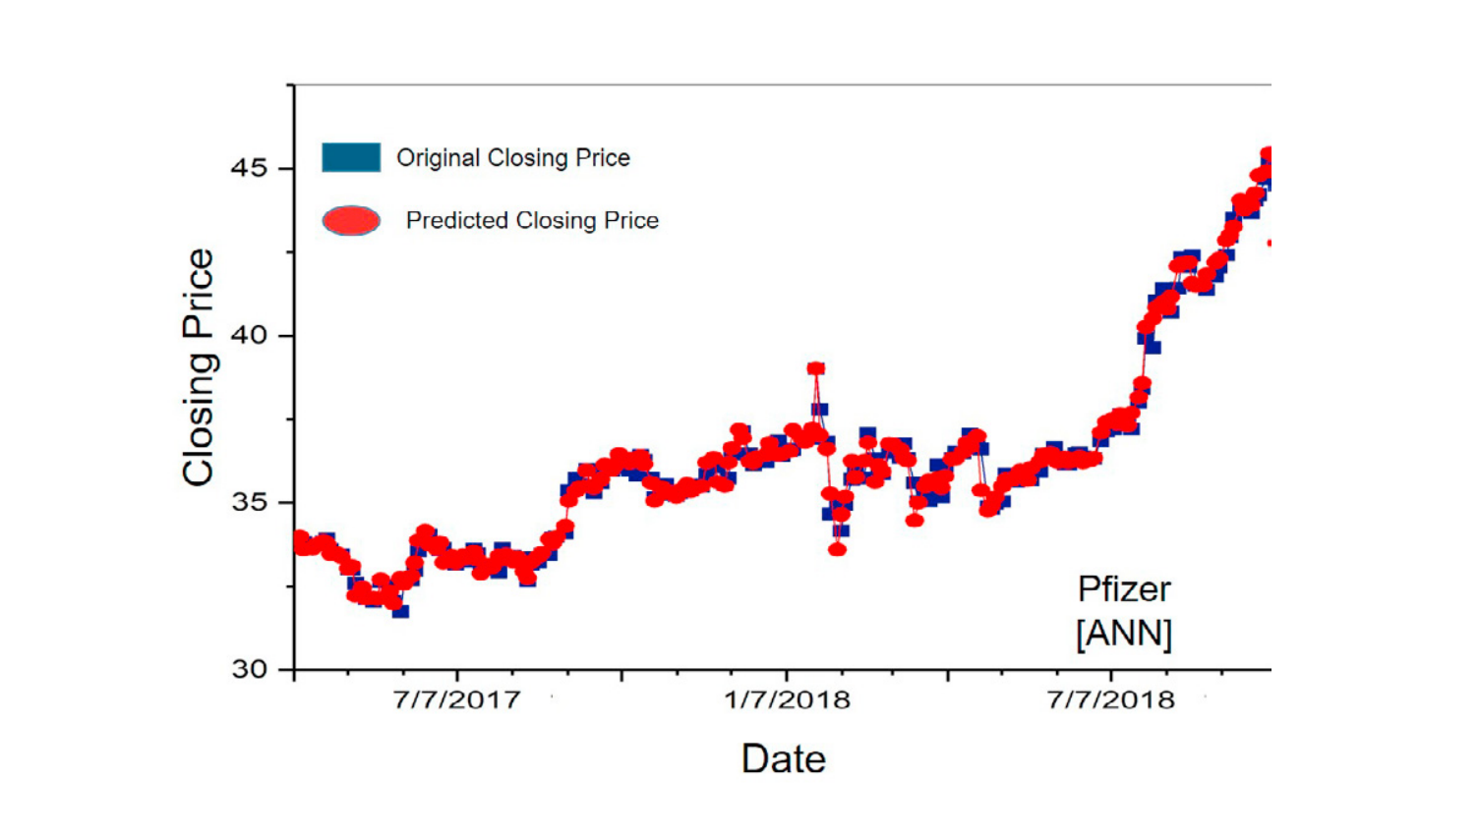
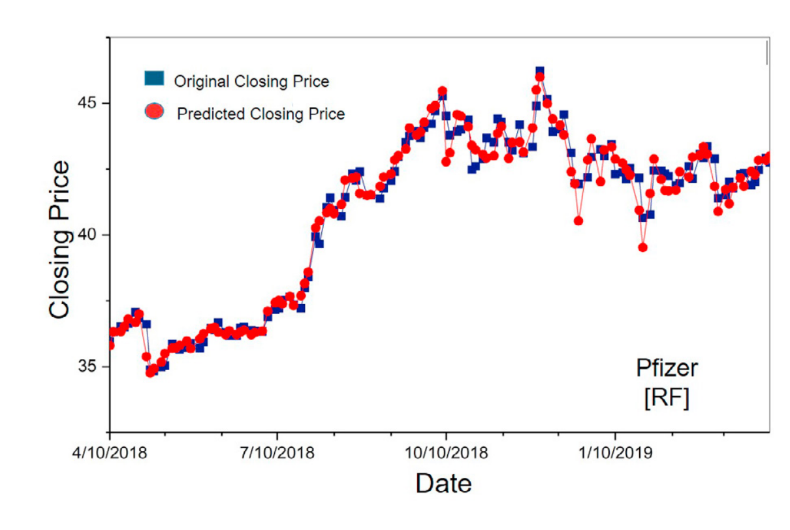
Basics About Study
Used to predict closing price of 5 stocks: Nike, Goldman Sachs, Johnson and Johnson, Pfizer and JP Morgan Chase and Co.
Uses 2 ML Models:
Artificial Neural Network
Random Forest Model
Trained Data Set from 2009 - 2017
Tested Data from 2017 - 2019
Vijh, Mehar et. al
ANN Model
RFM
Model
Notes:
Andrew

Slide 3
Getting Data
Input Variables for ML Models Computed:
1. Stock High minus Low price (H-L)
2. Stock Close minus Open price (O-C)
3. Stock price’s seven days’ moving average
(7 DAYS MA)
4. Stock price’s fourteen days’ moving average (14 DAYS MA)
5. Stock price’s twenty one days’ moving average (21 DAYS MA)
6. Stock price’s standard deviation for the past seven days (7 DAYS STD DEV)
Obtained on Yahoo Finance
Given Columns for Each Company:
Date
Open
High
Low
Close
Adj Close
Volume

Slide 4
ANN MODEL

Slide 5
ANN Model: Steps taken to develop/code model
Data preprocessing
Importing training and testing sets for each company
Creating layers
Creating input layer, 3 hidden layers, and output layer
Customizing them to fit the study
Compiling the model
Fitting the model to the training sets and predicting the test set results
Predicted each company’s stock closing prices
Calculated the expected error values

Slide 6
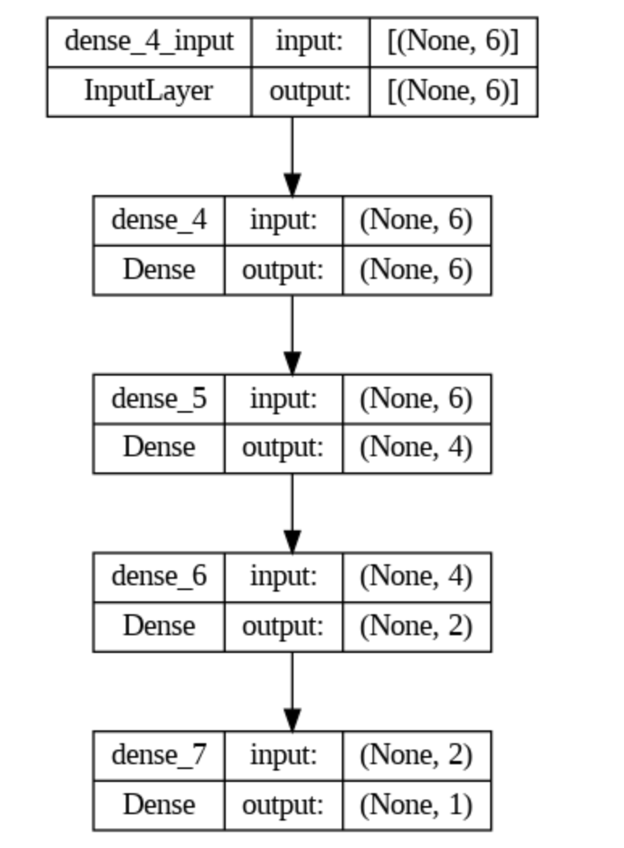
ANN Model: Visualizing Layers
Consisting of:
An input layer
3 hidden layers
An output layer
Each layer has a different number of neurons representing the number of input variables

Slide 7
ANN Model: Error results
Expected
Our results
Ticker | RMSE | MAPE | MBE
NKE | 1.10 | 1.07% | -0.0522
GS | 3.30 | 1.09% | 0.0762
JPM | 1.28 | 0.89% | -0.0310
JNJ | 1.54 | 0.70% | -0.0138
PFE | 0.42 | 0.77% | -0.0156
Ticker | RMSE | MAPE | MBE
NKE | 0.49 | 0.54% | 0.0413
GS | 2.69 | 0.91% | -1.5762
JPM | 0.69 | 0.49% | -0.0295
JNJ | 1.02 | 0.54% | -0.4970
PFE | 0.21 | 0.43% | -0.0312

Slide 8
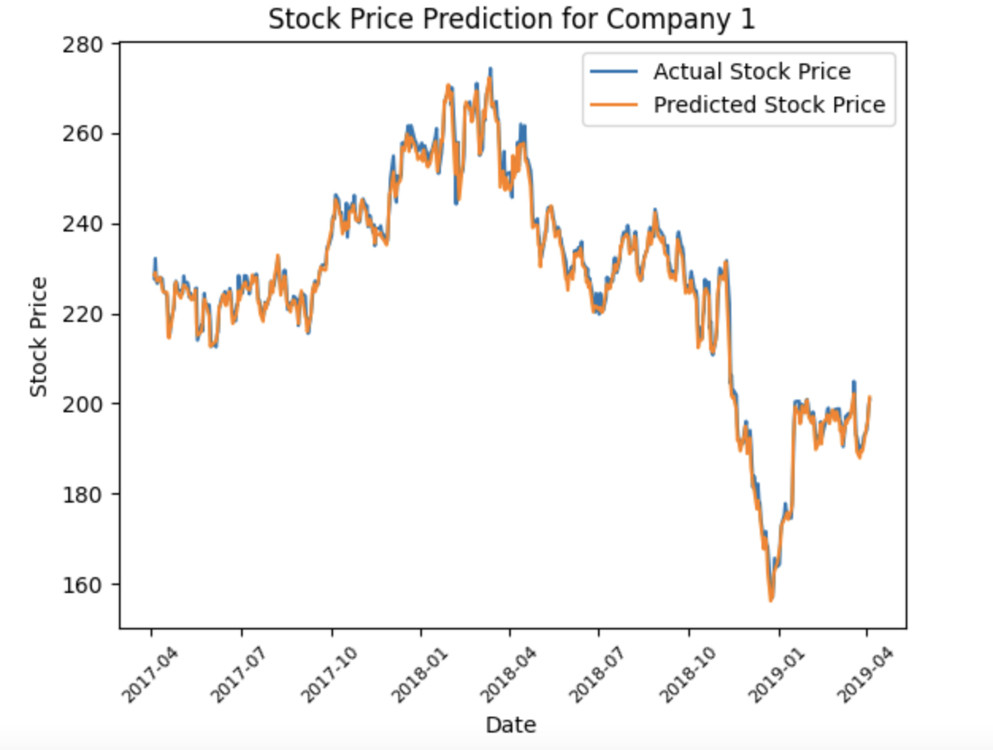
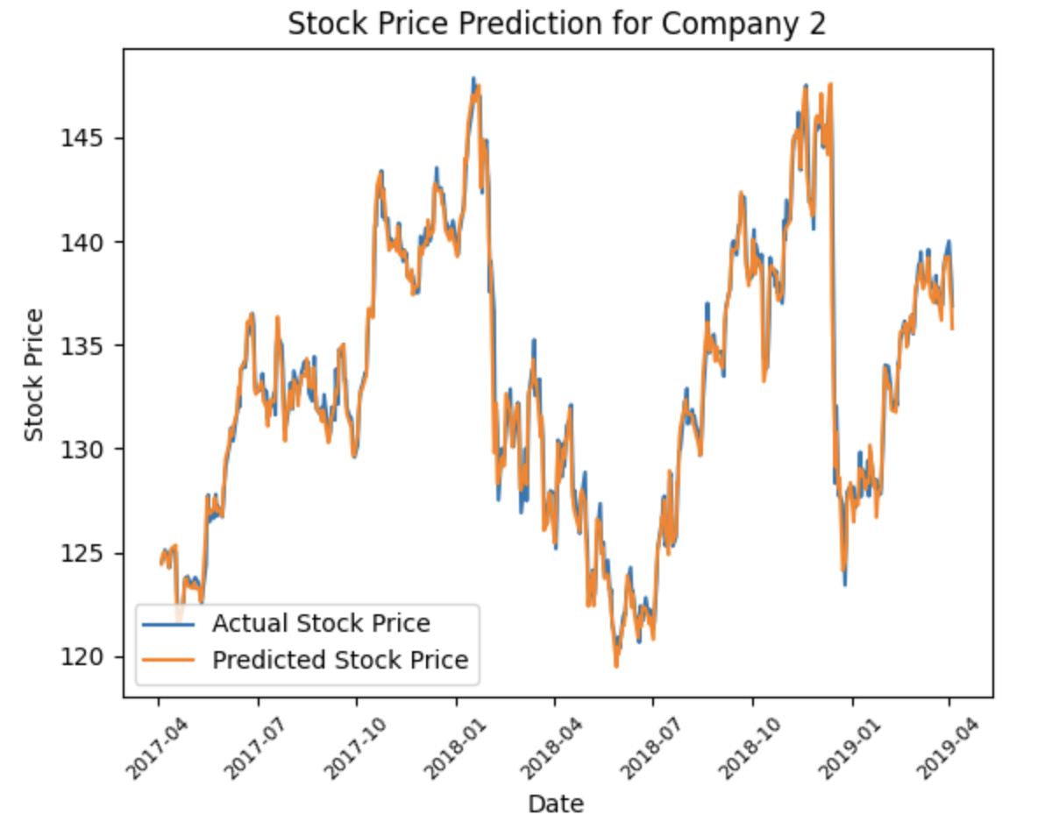
ANN Model: Graphs!

Slide 9
RF MODEL

Slide 10
RF results
Ticker | RMSE | MAPE | MBE
NKE | 1.29 | 1.14% | -0.0521
GS | 3.40 | 1.01% | 0.0761
JPM | 1.41 | 0.93% | -0.0313
JNJ | 1.53 | 0.75% | -0.0138
PFE | 0.43 | 0.8% | -0.0155
Ticker | RMSE | MAPE | MBE
NKE | 103.76 | 9.41% | 6.83
GS | 112.50 | 3.56% | -1.52
JPM | 274.58 | 12.98% | 13.76
JNJ | 112.35 | 6.35% | 8.55
PFE | 15.88 | 6.49% | 2.45

Slide 11
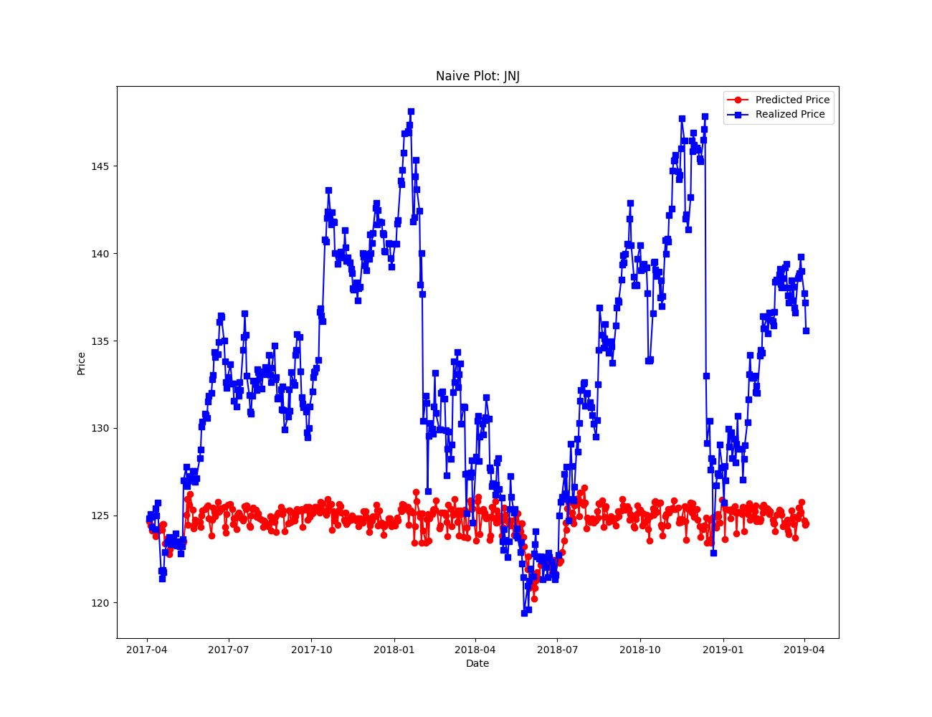
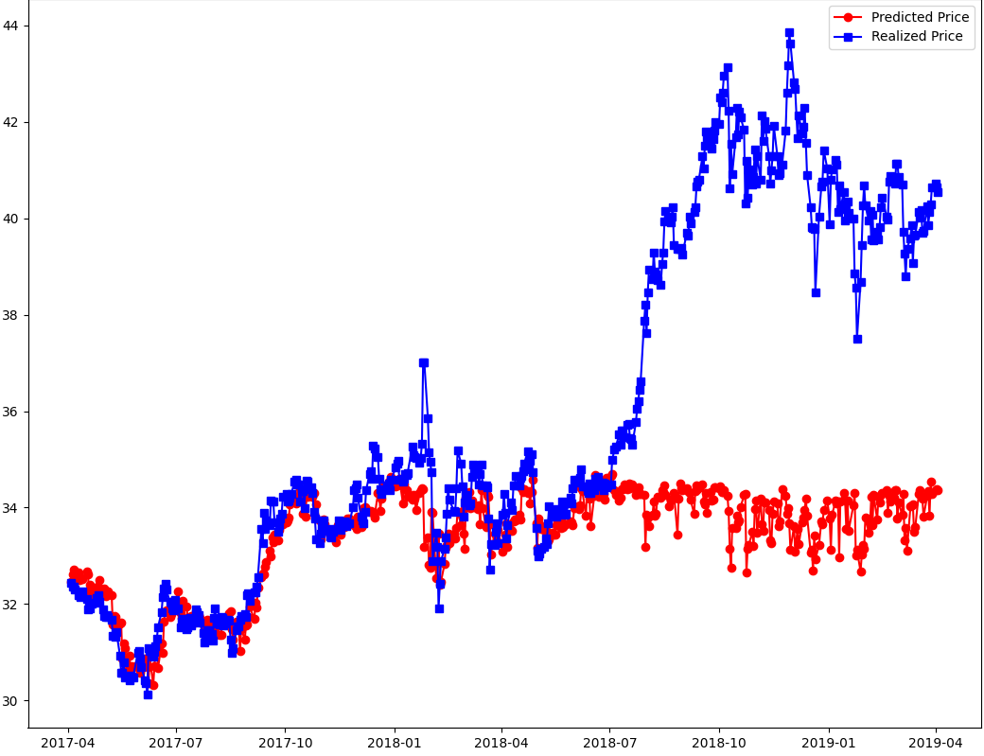
That’s Not Supposed to Happen

Slide 12
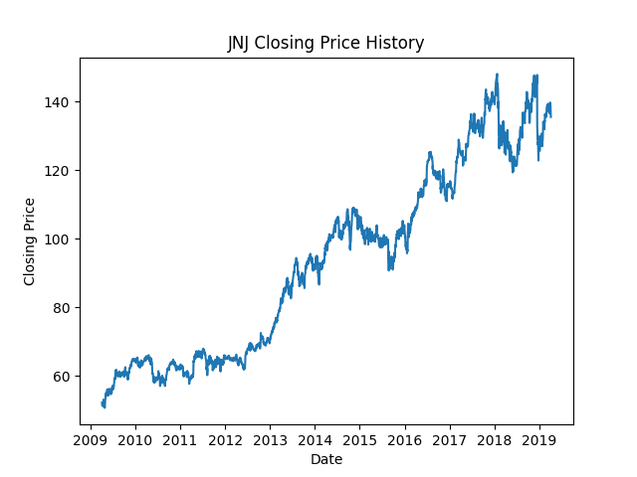
Why is this Happening?
Let’s take a look at the price history
The majority of the testing data has no close examples in the testing data
The nature of the market

Slide 13
Interesting…

Slide 14
That’s More Like it
Ticker | RMSE | MAPE | MBE
NKE | 1.29 | 1.14% | -0.0521
GS | 3.40 | 1.01% | 0.0761
JPM | 1.41 | 0.93% | -0.0313
JNJ | 1.53 | 0.75% | -0.0138
PFE | 0.43 | 0.8% | -0.0155
Ticker | RMSE | MAPE | MBE
NKE | 0.88 | 0.85% | 0.0066
GS | 9.613 | 0.92% | -0.1915
JPM | 1.13 | 0.72% | 0.0772
JNJ | 1.42 | 0.59% | 0.0288
PFE | 0.09 | 0.52% | 0.0066

Slide 15
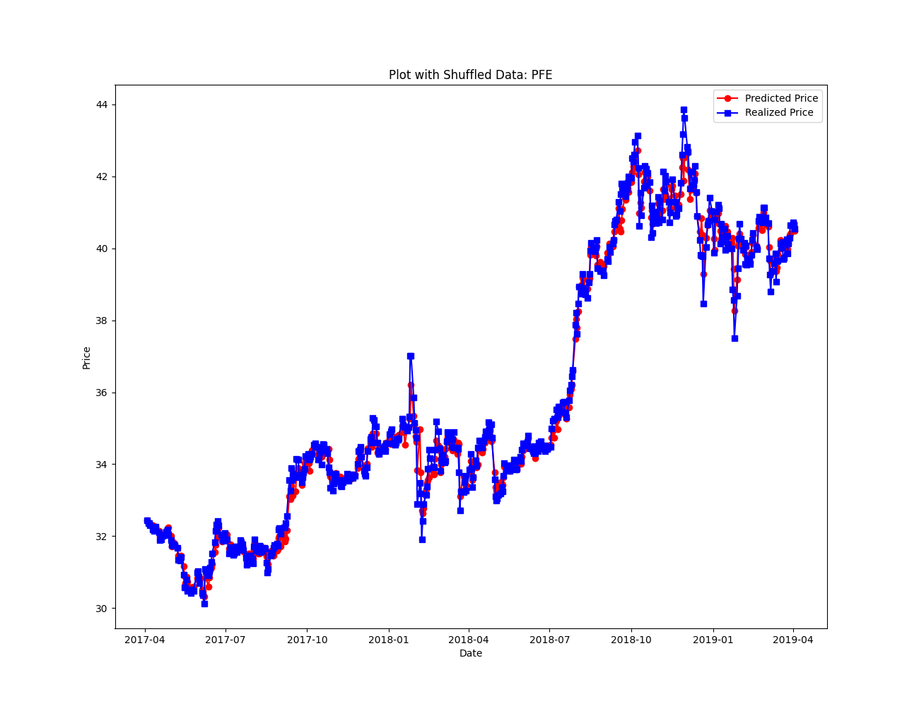
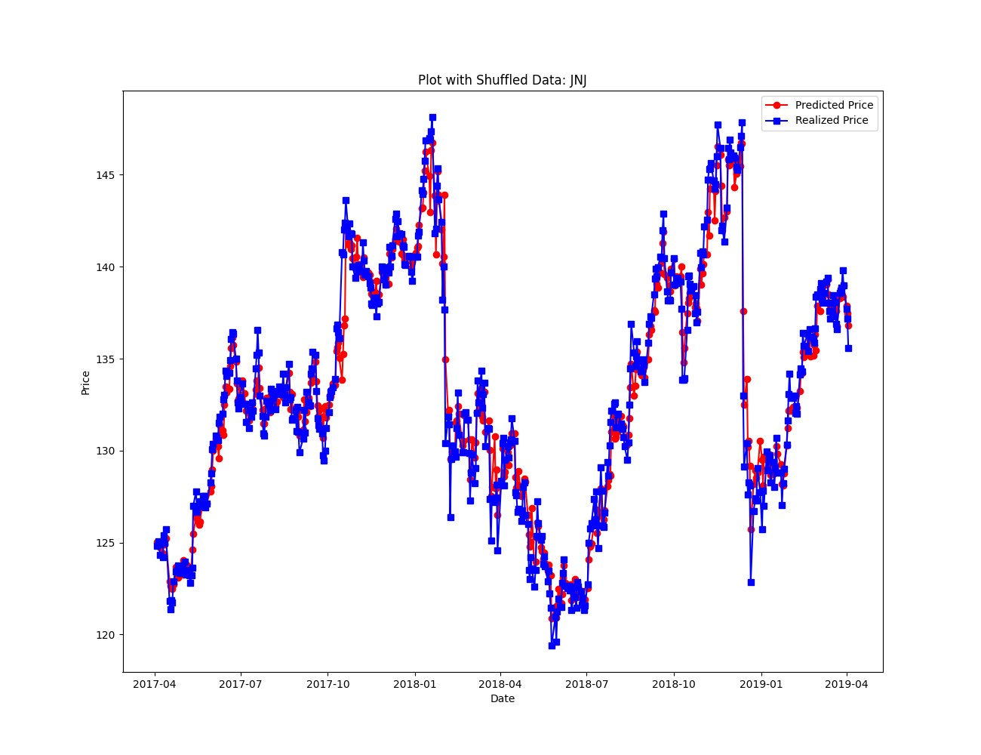
That’s More Like it

Slide 16
How Did I do That?
By cheating
By shuffling the data around, we were able to reach very similar numbers to the study
This suggests that the authors accidentally shuffled the data around in cross validation and leaked the parts of the test dataset

Slide 17
Can we get Similar Numbers without Cheating?
Yes
Retraining up to each index, then predicting that index
Training set = data[0 : index]
Testing set = data[index : len(data)]

Slide 18
Numbers from the new Strategy
Ticker | RMSE | MAPE | MBE
NKE | 1.29 | 1.14% | -0.0521
GS | 3.40 | 1.01% | 0.0761
JPM | 1.41 | 0.93% | -0.0313
JNJ | 1.53 | 0.75% | -0.0138
PFE | 0.43 | 0.8% | -0.0155
Ticker | RMSE | MAPE | MBE
NKE | 1.53 | 1.25% | 0.1216
GS | 13.51 | 1.2% | -0.2566
JPM | 2.14 | 1.04% | -0.0321
JNJ | 2.64 | 0.85% | -0.0721
PFE | 0.20 | 0.86% | 0.0104

Slide 19
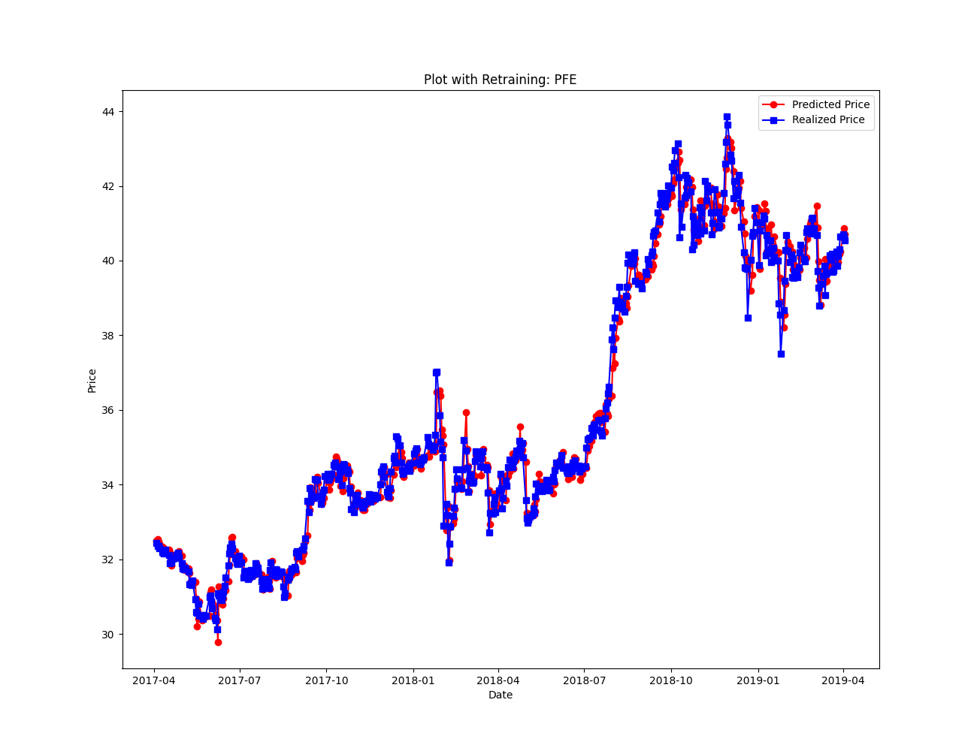
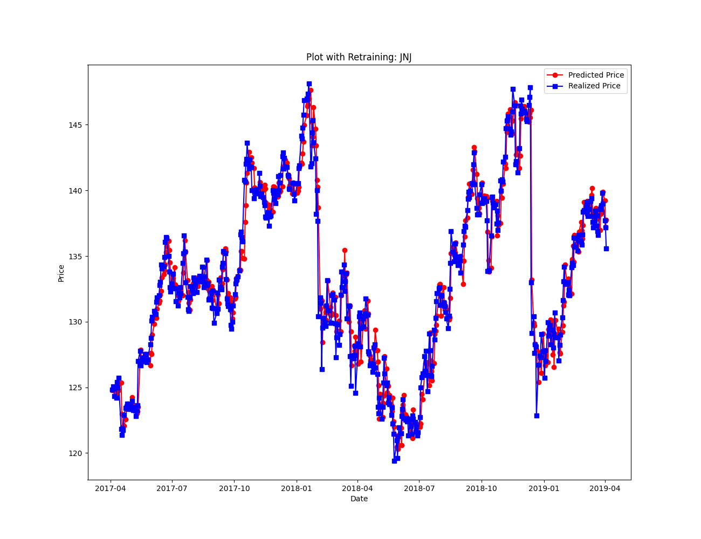
Graphs from the new Strategy

Slide 20
Difficulties
Data Extraction:
Few NaN values when computing moving averages.
Fixed by removing values before inputting in ML models
RF Model:
Unclear explanations of procedure in paper
Fixed by working with Dr. Reguly to develop our own, comparable procedure
ANN Model
Calculating close enough error values
Fixed by increasing the number of epochs (giving the model more opportunities to adjust its weights) and the Adam optimizer (allowing the model to more efficiently update its parameters during training)

Slide 21

Plans for Future
Hope to create our own ML model to predict next-day stock prices.
Goal will be to outperform RF and ANN model used in this paper.

